Slide 1
Society of Women Engineers
September General Meeting

Slide 2
Agenda
September 2020
Officer Introductions
What is SWE?
Professional Events
Volunteering Events
Outreach Events
Social Events
GradSWE

Slide 3
Introductions

Slide 4
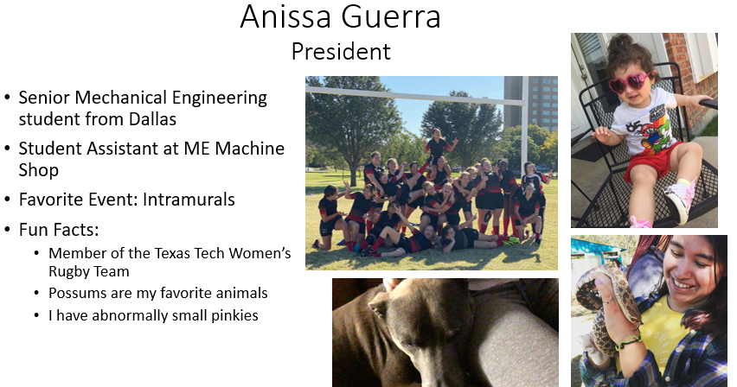

Slide 5


Slide 6
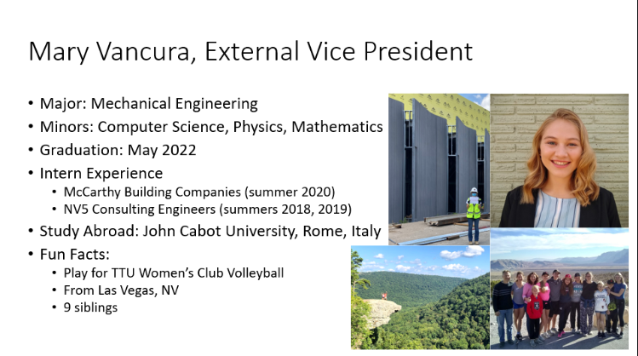

Slide 7
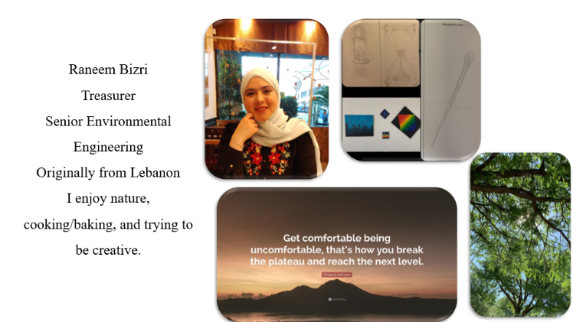

Slide 8
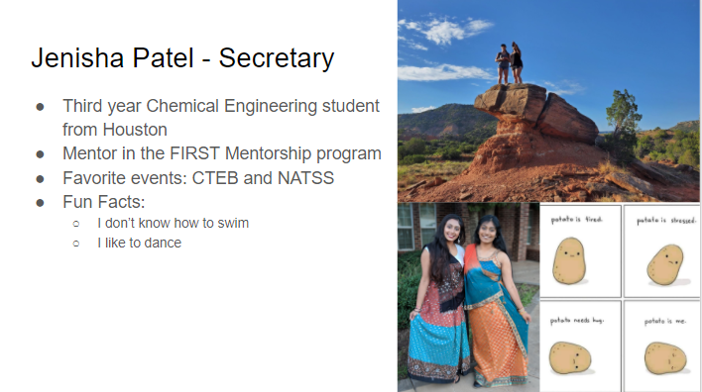

Slide 9
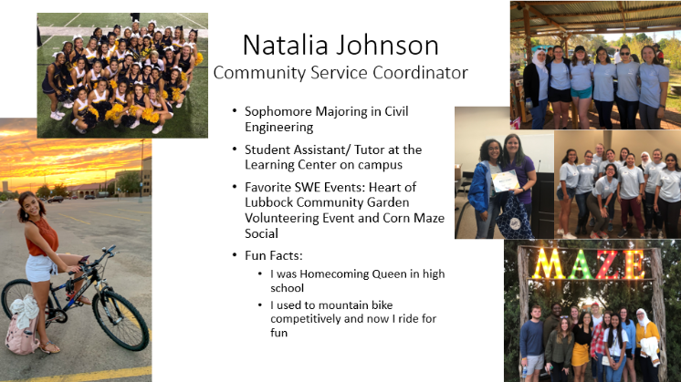

Slide 10
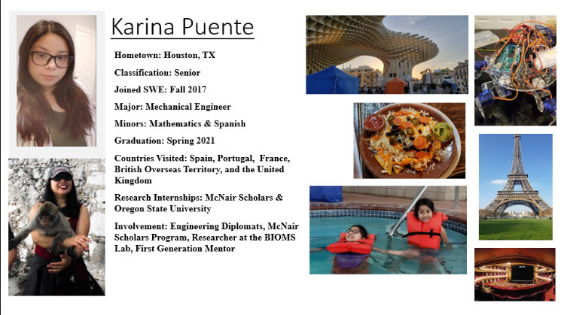

Slide 11


Slide 12
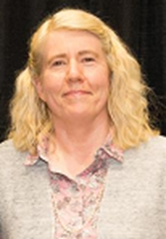
Susan Mengel, PhD
Advisor
Associate Professor, Texas Tech University,
Department of Computer Science
FY19 SWE Outreach Committee Chair
FY18 SWE Outreach Chair Elect
FY17/18 Assessment Workgroup Lead, SWE Outreach Committee
Faculty Advisor, Texas Tech SWE Collegiate Section
Research Interests – Big Data, Information Retrieval, STEM Outreach
Teach undergraduate and graduate software engineering and big data mining classes

Slide 13
What is SWE?

Slide 14


Slide 15
Professional Events

Slide 16

Corporate Cocktail
Virtual, Joint Event with NSBE and SHPE
Friday, September 18 @6:30 PM
  Meet with recruiters before the job fair
  Be on the lookout for the zoom link we will send out!

Slide 17
Volunteer Events

Slide 18
Volunteering Opportunities this Month
We are still competing in the S2S challenge for Schlumberger this year
T-shirt Sizes (sent in a link)
1) Feed Seniors Now Volunteering Event (Off-campus Event)
Date: 9/19/20
Time: 10 am - 4 pm (sign up for individual 2-hour shifts)
Location: Walmart Supercenter (Subject to change)
4215 S Loop 289
Lubbock, TX 79423
2) Student Activities Board Service Week(On-campus Event)
Dates: 9/21/20-9/25/20
Time: TBA (Possibly around lunchtime/in between classes throughout the week)
Location: (update)They are all virtual
Please check out the google form sent in the chat to sign up for your desired volunteering events and times based on your availability!!!
Make sure to put these events in your calendar and look at emails for updates!!!!!!!!
If you need a ride for any of these events or have any other questions, please email me at Natalia.d.johnson@ttu.edu

Slide 19
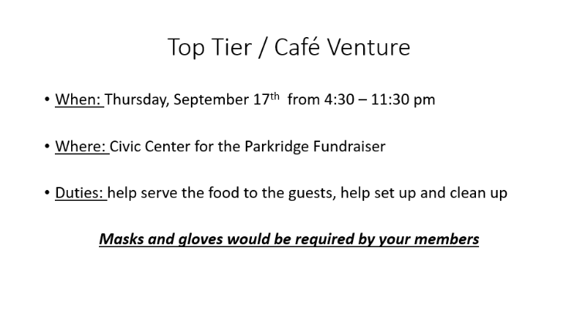

Slide 20
Outreach Events

Slide 21

Fall Outreach
Virtual activities and demonstrations with local girls
Hopefully will have Science Spectrum joining us
We need you guys to help lead activities online and other needs we may need help with
We will supply you with materials, directions, and talking points for activities
Interested? Please sign up on spreadsheet, or email me
Kodi.Kirtland@ttu.edu
https://docs.google.com/spreadsheets/d/1-T8vNU7qfQcNppPqPg15Ma8C72lUsWlp7riLwd1soaA/edit?usp=sharing
Teamwork is the key to success

Slide 22
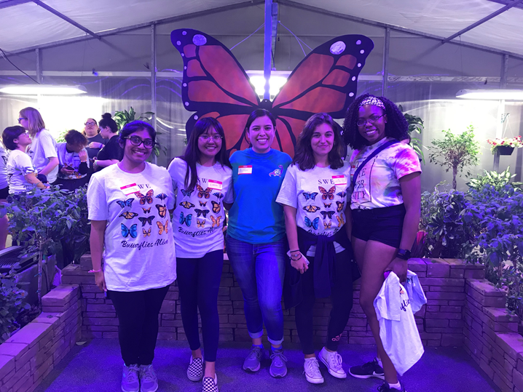
Outreach Committee!!!
If you are passionate about outreach and want a leadership role in SWE, please apply for the committee!
The committee will help Kodi compete tasks and deadlines for the events
Great (virtual) teambuilding skills and involvement in SWE
  Great on a resume ;)
If you have any questions, please email me:
  Kodi.Kirtland@gmail.com
Complete Application (Google Form) by 9/19
https://docs.google.com/forms/d/e/1FAIpQLSfes7L1Qq59jFg7qb3DMCX4EVzMQqUCaplbAYa1aPuzoMKvpw/viewform?usp=sf_link

Slide 23




September Social – Lunch and a Movie
Grab your favorite lunch and join members
through Zoom and Netflix Party to watch a movie
Download Netflix Party extension to any web browser
  I will send directions if you have problem
Vote on the movie through this survey:
  https://www.surveymonkey.com/r/8NTDGS7
  September 26 @12 PM
  - Will send zoom link and Netflix Party directions in email and remind

Slide 24

GradSWE
Special mini-section for Graduate Students
More info to come
If you are interested please contact Elham Abaie
  Elham.Abaie@ttu.edu

Slide 25
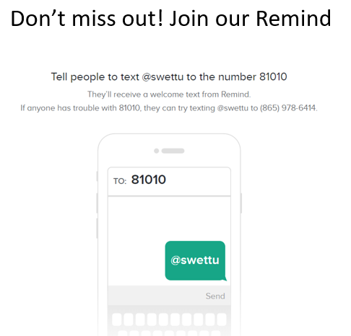

Slide 26
Thanks for coming!
Questions? Comments? Concerns?

